Slide 1
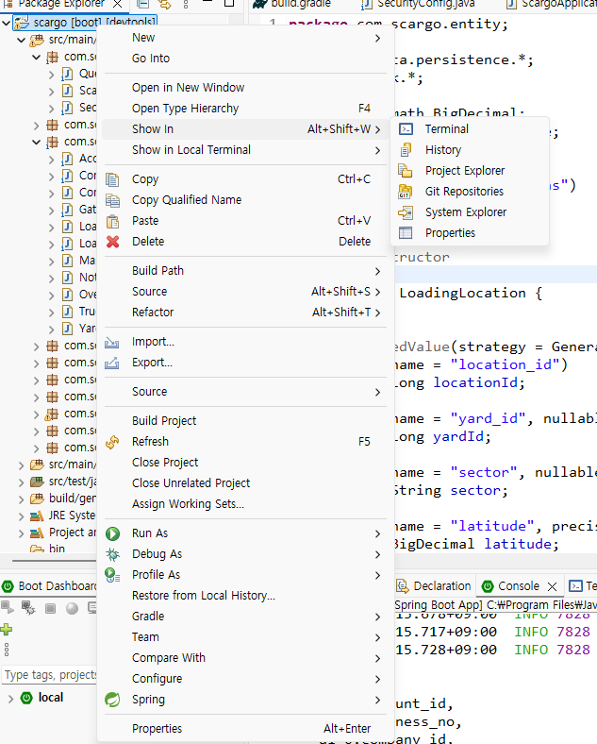

Slide 2
gradlew compileJava

